Slide 1
Cleaning Data Using SQL
Jeremy Bergmann - Omaha Data Science Academy

Slide 2
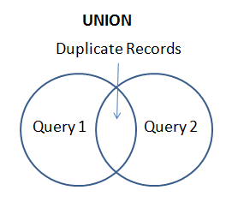
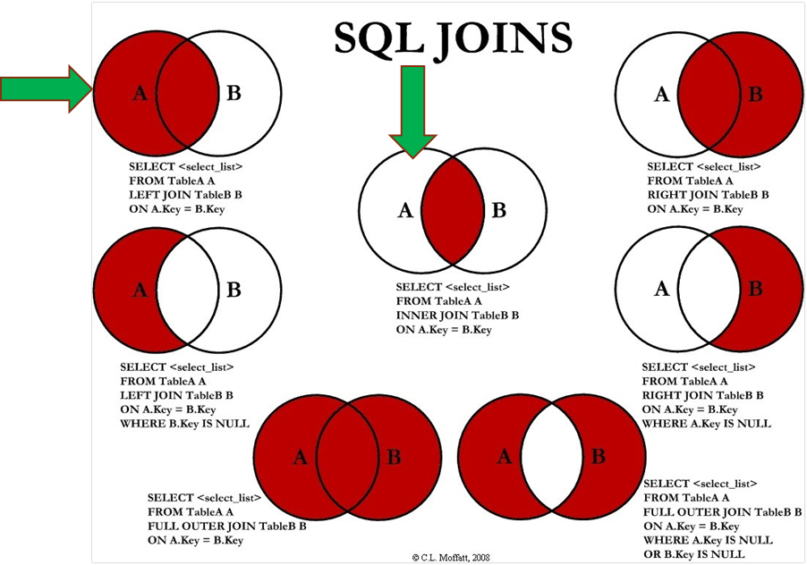
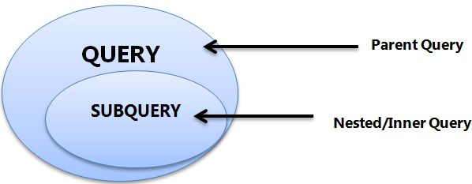
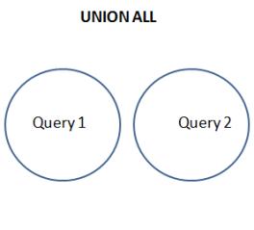
Review: Class 4 – Joining & Merging Data
Joining Data – Inner, Left/Right, Full Outer
Merging & Appending Data – Union, Union All
Subqueries – SELECT, FROM, WHERE Clauses
Notes:
Feynman technique: Learn -> Explain -> Reflect -> Repeat
What are the most important ideas from last class? Write a summary of the information as if explaining to a 14 year old. Avoid jargon Keep the words and sentences simple Rely on memory Make the explanation visual, if possible Note where you had difficulty or have knowledge gaps. These indicate things you should review, research, or ask questions about

Slide 3

Class 5 Objectives
Cleaning Data Using SQL
SQL Operators, Wildcards, Like, etc.
Case Statements & Logical Functions
Clean string, numeric, and date data
Perform joins - inner, outer and left
Notes:
Feynman technique: Learn -> Explain -> Reflect -> Repeat
What are the most important ideas from last class? Write a summary of the information as if explaining to a 14 year old. Avoid jargon Keep the words and sentences simple Rely on memory Make the explanation visual, if possible Note where you had difficulty or have knowledge gaps. These indicate things you should review, research, or ask questions about

Slide 4
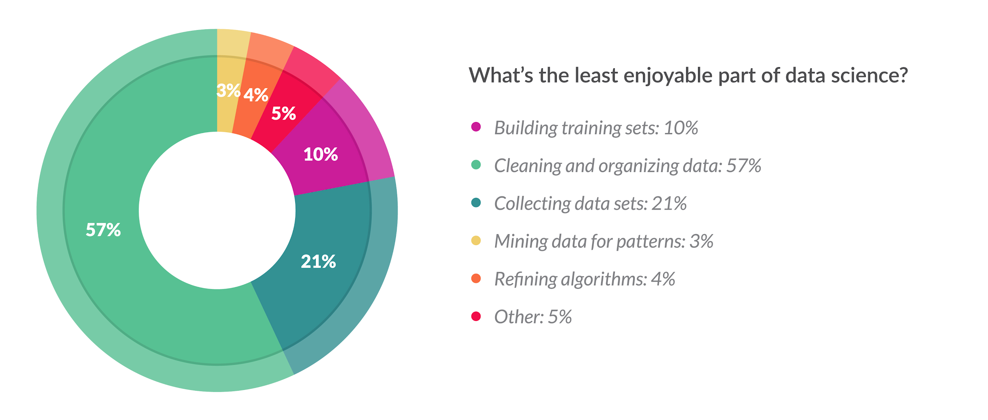
Cleaning Data
What Does Cleaning Data Mean?
Data cleaning is the process of confirming the Validity, Accuracy, Completeness, Consistency, and Uniformity data
How Can You Clean Data?
Using business knowledge, along with software tools or a coding language to clean data.
What About Programming Languages?
Cleaning data in a language like SQL or Python gives you flexibility to run routines for specific projects, while keeping costs low
Python: Pandas, Dora, data cleaner, tabulate, scrubadub, and many other Python libraries.
SQL: T-SQL, Text & Date Functions, Case Statements, “Where” clause, Select Distinct
Notes:
Validity - absence of differences between the data items representing the same objects based on specific information requirements
Accuracy - degree to which the data item correctly describes the object in context of appropriate real-world context and attributes
Completeness - An indication of the comprehensiveness of available data,
Consistency - absence of differences between the data items representing the same objects based on specific information requirements (across data sources/Tables)
Uniformity - Absolute, or very high degree of, comparability between two or more alternatives, processes, products, qualifications, sets of data

Slide 5
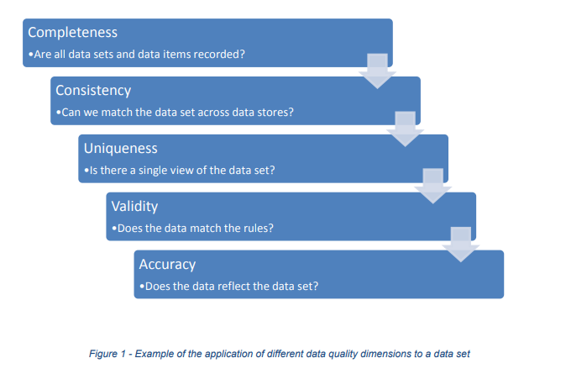
Goals of Cleaning Data
Remove Unwanted Observations
Duplicate Observations arise when you combine datasets from multiple places, scrape data, and receive data from clients/other departments.
Irrelevant Observations & Outliers are those that don’t fit the specific problem you’re trying to solve.
Fix Structural Errors that occur during measurement or data transfer.
Ex. Multiple ways to spell a word or mislabeled classes.
Handle Missing
Dropping observations that have missing values
Imputing the missing values based on other observations.
There are other possible ways to clean data, such as: (transforming files, statistical methods) but these steps will always be performed on any dataset you analyze.
Notes:
The goal of cleaning is ultimately to confirm the Validity, Accuracy, Completeness, Consistency, and Uniformity of the dataset

Slide 6
SQL Wildcards
Purpose: Used with the SQL “like” operator, A wildcard character is used to for comparing and/or substituting one or more characters in a string.
Symbol | Description | Example
% | Represents zero or more characters | bl% finds bl, black, blue, and blob
_ | Represents a single character | h_t finds hot, hat, and hit
[] | Represents any single character within the brackets | h[oa]t finds hot and hat, but not hit
^ | Represents any character not in the bracket | h[^oa]t finds hit, but not hot and hat
- | Represents a range of characters | c[a-b]t finds cat and cbt
Examples With the “like” operator: https://www.w3schools.com/sql/sql_wildcards.asp
MSSQL Syntax - See MySQL World examples in the class file: “Lectures/Examples – Powerpoint SQL.sql
Notes:
MySQL – First two Wildcards
MS SQL & Access – last 3

Slide 7

Removing Duplicates
Purpose - Improve the Accuracy, Consistency and the Uniformity of data by removing identical observations that appear more than 1 time in a SQL Table.
3 Methods
1. Select “Distinct” Keyword
2. Finding Duplicates by Key (joins)
3. Finding Duplicates via Aggregation
Notes:
https://codingsight.com/multiple-ways-to-remove-duplicates-from-sql-tables/

Slide 8
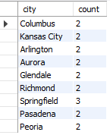
Identifying Duplicates by Aggregation
Find USA Cities with the same name (duplicate records)
SELECT `name` AS city, SUM(1) AS `count`
FROM world.city
WHERE countrycode='USA'
GROUP BY `name`
HAVING count > 1
Notes:
SELECT a.*
FROM world.city AS a INNER JOIN
(
SELECT `name` AS city, SUM(1) AS `count`
FROM world.city
WHERE countrycode='USA'
GROUP BY `name` HAVING SUM(1) > 1
) AS b ON a.`name` = b.city
WHERE a.countrycode='USA' ORDER BY a.`name`;

Slide 9
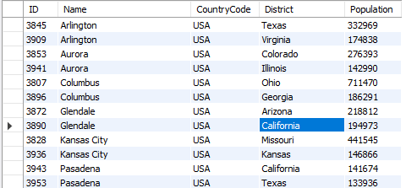
Identifying Duplicates by Key
Find USA Cities with the same name (duplicate records)
SQL Query - Find Via Aggregate & Join
SELECT a.*
FROM world.city AS a INNER JOIN
(SELECT `name` AS city, SUM(1) AS `count`
FROM world.city
WHERE countrycode='USA'
GROUP BY `name`
HAVING count > 1) AS b ON a.`name` = b.city
WHERE a.countrycode=‘USA’
ORDER BY a.`name`
Notes:
SELECT a.*
FROM world.city AS a INNER JOIN
(
SELECT `name` AS city, SUM(1) AS `count`
FROM world.city
WHERE countrycode='USA'
GROUP BY `name` HAVING SUM(1) > 1
) AS b ON a.`name` = b.city
WHERE a.countrycode='USA' ORDER BY a.`name`;

Slide 10
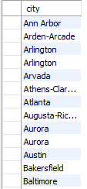
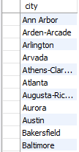
Using DISTINCT Keyword
Remove USA Cities with the same name (duplicate records)
Using DISTINCT
SELECT `name` AS city
FROM world.city
WHERE countrycode='USA'
ORDER BY `name`;
SELECT DISTINCT `name` AS city
FROM world.city
WHERE countrycode='USA'
ORDER BY `name`;

Slide 11
SQL Scalar Functions
String functions: Concat, Length, Left, Replace, Substring, Trim, Format
Control flow functions: Case, if, ifnull
Date and Time functions: Curdate, DateDiff, Day/Month/Year, DateAdd, now
Comparison functions: Coalesce, isnull
Numeric/Math functions: Format, Ceiling/Floor, Round, Truncate
Data Types: CAST
Tutorial: http://www.mysqltutorial.org/mysql-functions.aspx
Notes:
Aggregate Function: aggregate function performs a calculation on a set of values and returns a single value.
scalar(non-aggregate) functions - returns a single data value and operate on each record independently.

Slide 12
Numeric & Comparison Functions
Function | Description | Example
FORMAT (N, D) | Number N to a format like ‘#,###,###.##’ rounded to “D” decimal places | SELECT FORMAT(12324.2573, 3) = 12,324.257
CAST (value, type) | The CAST() function converts a value (of any type) into the specified datatype. | SELECT CAST ('150' AS Unsigned)= 150
IFNULL (expr ,alt_value) | returns a specified value if the expression is NULL. | IFNULL(NULL, 500) = 500
ISNULL(exp) | returns 1 or 0 depending on whether an expression is NULL. | ISNULL(NULL) = 1
COALESCE (val1,val2,…,val_n) | Function returns the first non-null value in a list. | COALESCE(NULL, 'W3Schools.com', NULL, 'Example.com’)= 'W3Schools.com'
See more numeric functions at: https://www.w3resource.com/slides/mysql-mathematical-functions-slides-presentation.php
For CAST() data types, see: https://www.w3resource.com/slides/mysql-mathematical-functions-slides-presentation.php

Slide 13
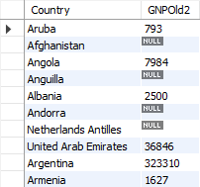
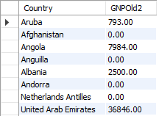
Ex. Numeric Functions
Fill-in and convert `GNPOld` values in World.Country
SQL Query - Undesired Types - Convert Decimal to Integer
SELECT `name` AS country, CONVERT(ROUND(gnpold,0),UNSIGNED) AS gnpold2 FROM world.country;
SQL Query - Coalesce “0” for Null Values
SELECT `name` AS country, COALESCE(gnpold,0) as gnpold3 FROM world.country;

Slide 14
String Formatting Functions
Function | Description | Example
CONCAT (Str1,..,StrN) | Add two or more strings together | SELECT CONCAT(“Jeremy ”,”T. ”, ”Bergmann”) = ‘Jeremy T. Bergmann’
INSTR (orig, substr) | Returns an integer which indicates the position of the first occurrence of the substr. | INSTR('myteststring','st') = 5
TRIM (expr ,alt_value) | string after removing all prefixes or suffixes from the given string. | TRIM(LEADING 'leading' FROM 'leadingtext' ) = ‘text’
REPLACE (str, find, sub) | replaces all the occurrences of a substring within a string | REPLACE('w3resource','ur','r') = ‘w3resorce’
LCASE(str), UCASE(str) | converts the characters of a string to lower/upper case characters. | LCASE('MYTESTSTRING') = ‘myteststring’
LENGTH(str) | returns the length of a given string. | LENGTH(‘Bergmann’) = 8
SUBSTRING (str, start, length) | Extracts some characters from a string | SUBSTRING('SQL Tutorial', 1, 3) = SQL
Notes:
See more string functions at: https://www.w3schools.com/sql/sql_ref_sqlserver.asp
For Cast() data types, see: https://www.w3resource.com/slides/mysql-mathematical-functions-slides-presentation.php

Slide 15
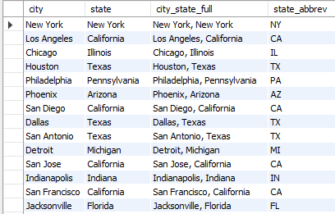
Ex. String Functions
Convert USA City & State Names to “City, St.” in World.City
SQL Query
SELECT `name` AS city, district AS state ,
CONCAT(`name`, ‘,’, district) AS city_state_full,
CASE WHEN district = 'New York’ THEN 'NY’
WHEN INSTR(district,'Tex') then 'TX’
WHEN district = 'Arizona’ THEN REPLACE(district, 'Arizona', 'AZ’)
WHEN TRIM(LEADING 'Penn’ FROM district) = 'sylvania’ THEN 'PA’
ELSE UPPER(LEFT(district,2)) END AS state_abbrev
FROM world.city AS a
WHERE a.CountryCode='USA'

Slide 16
Date Formatting Functions
Function | Description | Example
CURDATE() | Returns the current date in 'YYYY-MM-DD' format | SELECT CURDATE() = '2019-07-22'
CURRENT_TIMESTAMP() | Returns the current date and time in ‘YYYY-MM-DD HH:MM:SS’ format | CURRENT_TIMESTAMP() = ‘2019-07-22 13:41:53’
HOUR(time) | Returns a specified value if the expression is NULL. | HOUR(CURRENT_TIMESTAMP()) = 13
DATEDIFF (date1, date2) | Returns the number of days between two dates or datetimes (using only date portion) | DATEDIFF(CURDATE(), ‘1999-12-31’) = 7143
DAYOFWEEK (date) | Returns the weekday number (1 for Sunday, 2 for Monday, …… ,7 for Saturday) | DAYOFWEEK(CURDATE()) = 2
DAY(date), MONTH(date), YEAR(date) | Return the day of the month/month of year/calendar year of the input date. | DAY('2008-05-15') = 15 MONTH('2008-05-15') = 5 YEAR('2008-05-15') = 2008
CURDATE() | returns the current date in 'YYYY-MM-DD' format | SELECT CURDATE() = '2019-07-22'
Notes:
See more numeric functions at: https://www.w3resource.com/slides/mysql-mathematical-functions-slides-presentation.php
For Cast() data types, see: https://www.w3resource.com/slides/mysql-mathematical-functions-slides-presentation.php

Slide 17
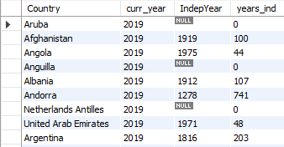
Ex. Date Functions
Get the number of years since each country’s independence
SQL Query
SELECT `name` AS country, YEAR(CURDATE()) AS curr_year, indepyear,
CASE WHEN indepyear IS NULL THEN 0
ELSE YEAR(CURDATE())-indepyear END AS years_ind
FROM world.country;

Slide 18
Common SQL Syntax Errors
JOINING ON THE WRONG COLUMN
Spelling – Table, Column, Value
Quotes - SINGLE (' '), DOUBLE (" "), and BACKTICKS (` `)
DATA TYPES – Ex. Integer as VARCHAR
Order of SQL Clauses (from lecture 1)
JOINING ON THE WRONG COLUMN
OVER FILTERING (WHERE Clause)
Source: https://datapractices.org/courseware/2_7.html
MySQL Error Message List: https://www.fromdual.com/mysql-error-codes-and-messages
Notes:
https://stackoverflow.com/questions/1992314/what-is-the-difference-between-single-and-double-quotes-in-sql - [S]ingle quotes are for [S]trings ; [D]ouble quotes are for [D]atabase identifiers;

Slide 19
Project Milestones
Query Data for Data Understanding/Relevant Information (Class 2)
Import data into MySQL database (Class 3)
Storing/Joining data for analysis (Class 4)
Cleaning Data (Class 5)
Normalize Data & Create Data Model (Class 6)
Analyze Data Quality & Create Data Dictionary (Class 7)
Finalize Project - Connect MySQL to PowerBI Cloud, Answer Business Questions (Class 8)

Slide 20

Class Project
Cleaning Data
The COO would like to know the volume of existing pre-orders for console games, to predict the most popular upcoming game genres. Utilize and clean the “USA Pre-Order Chart” data to answer this question.
1. Create a “USA_PreOrder_Chart” view that cleans-up the following data.
Change the “N/A” values in the “Weeks to Launch” column to 30, then cast the field as an Integer
Create “Console”, “Company” and “Genre” fields from the text in “Game_Console_Company_Genre”
For 1-10, Fill-In the “Game” & “Genre” columns with relevant values
Calculate the difference between today and the date the preorder list was last published. (‘2018-12-29’)
2. Select “Genre” and “Weeks to Launch” from the view you created, then summarize by “Total”. What Genre has the top pre orders as of EOY 2018, and what genre do you think will be best in 2019?
Notes:
USA Pre-Order Chart from (29-Dec-2018): http://www.vgchartz.com/preorders/43464/USA/

Slide 21
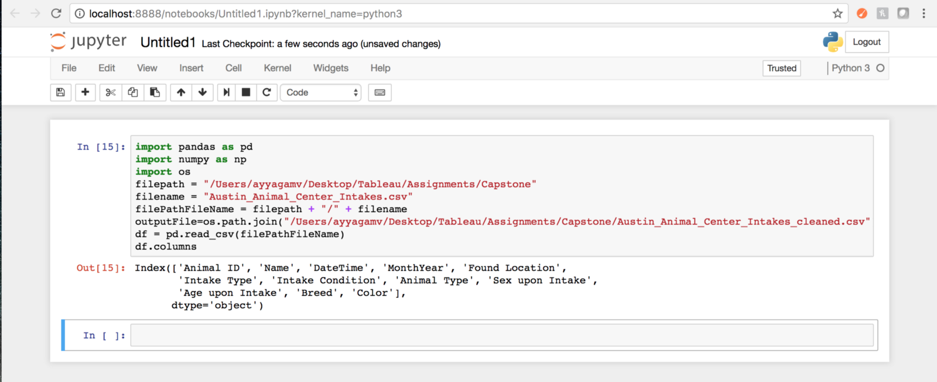
Appendix - Cleaning data: Python
Data scientists spend a large amount of their time cleaning datasets and getting them down to a form with which they can work. In fact, a lot of data scientists argue that the initial steps of obtaining and cleaning data constitute 80% of their job.
Tasks - Using Pandas Library
Dropping unnecessary columns in a Pandas DataFrame
Using .str() methods to clean columns
Using the DataFrame.applymap() function to clean the entire dataset, element-wise
Renaming columns to a more recognizable set of labels
Skipping unnecessary rows in a CSV file
Resource: Python for Data Analysis (O’Reilly)
*Cleaining Strings in python: https://mode.com/sql-tutorial/sql-string-functions-for-cleaning/
Notes:
Common ways to clean data with Python are available in the many libraries that you can import in your code. One of the most popular libraries is Pandas, which was designed for data manipulation and analysis, but is most commonly associated with data cleaning. Here is a common code snippet where Pandas is imported to clean a set of data:

Slide 22


